Slide 1
Mesopotamia and the
Fertile Crescent
ENTER

Slide 2
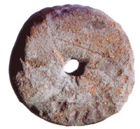
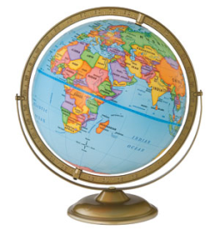
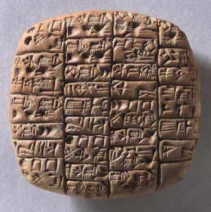
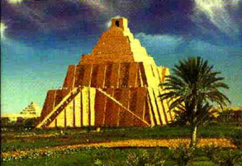
This is the KEY PAGE. It tells you what will happen when you click on
different things throughout this Power Point.
When you click this arrow it will always
take you back to the last page you viewed.
The picture of the first wheel will take you
to the page about Ancient Sumer.
This picture of Cuneiform writing will take
you to a vocabulary page where you can click
to see different words and people.
The picture of the globe will take
you to a geography page.
Click here when
ready to begin!
This picture of a Ziggurat will always take
you to the HOME page.

Slide 3
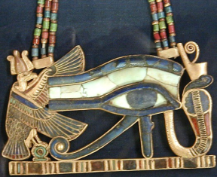
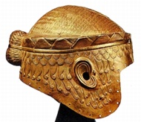
HOME

Slide 4
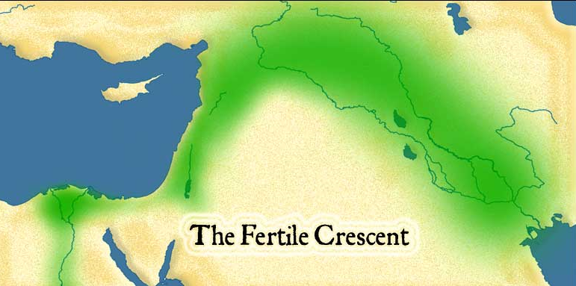
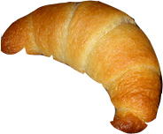
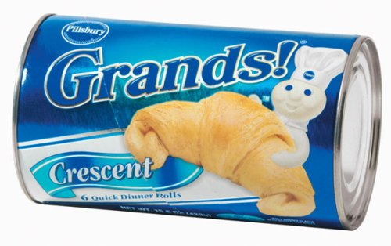
Where is the Fertile Crescent located?
Southwest Asia
The Fertile Crescent is located in ___________ .
It is between _________ and the ___________.
The
Mediterranean Sea
Persian Gulf
Where did the name Fertile Crescent come from?
The Fertile Crescent is Fertile because lots of plants can grow there.
It is known as the Fertile Crescent because it is shaped like a crescent.
Click here to see a map of the Fertile Crescent!

Slide 5
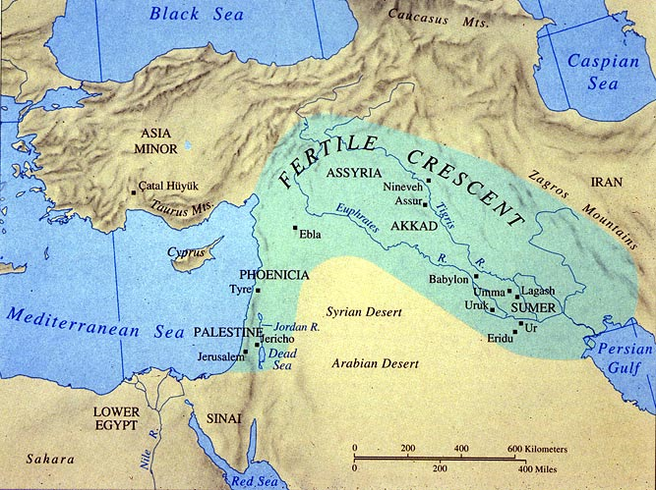
Can you find…?
The Tigris River?
The Euphrates River?
The Mediterranean Sea?
The Persian Gulf?
Where is Mesopotamia located?
*
*Between the Tigris and Euphrates Rivers
Click here to learn more
about Mesopotamia!

Slide 6
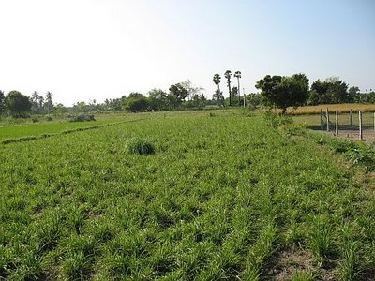
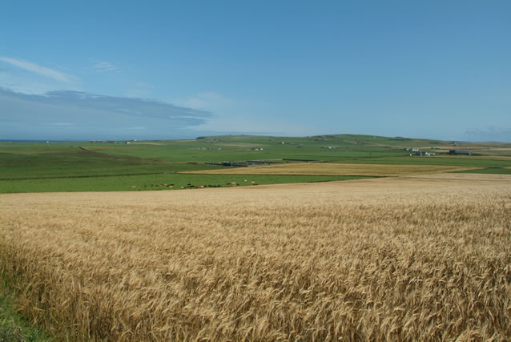
What is the Fertile Crescent?
The Fertile Crescent is a large arc of rich, fertile farmland.
F
ertile
A
R
M
What makes the farmland fertile?
WATER!
The fertile crescent is located between the Mediterranean Sea and Persian Gulf.
Two rivers that flow through the fertile crescent are _______________________.
the Tigris and Euphrates

Slide 7
Terms and People
Fertile Crescent
Gilgamesh
SILT
SARGON
Irrigation
EMPIRE
CANALS
Polytheism
SURPLUS
SOCIAL HIERARCHY
DIVISION OF LABOR
CITY-State
RURAL
URBAN

Slide 8
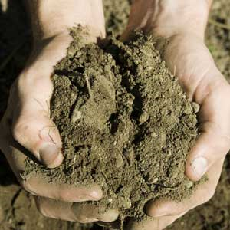
SILT
A mixture of fertile soil and tiny rocks that
makes land ideal for farming.
*THINK SOIL = SILT
Silt is soil, and soil is silt,
If we didn’t have silt
All of the plants would wilt!

Slide 9
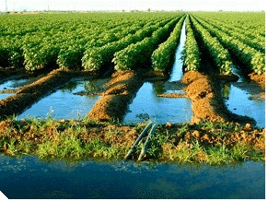
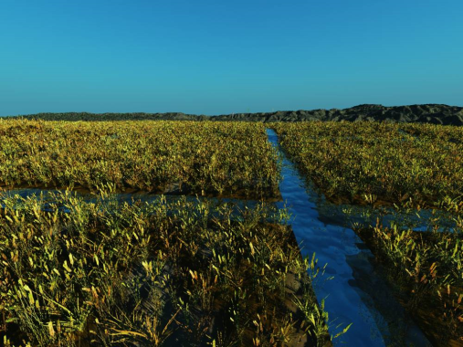
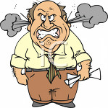
Irrigation
A way of supplying water to an area of land.
Settlements in Mesopotamia were located near rivers.
At first the water was not controlled, so flooding was a problem.
People built canals to protect houses from flooding and to move
water to their fields.
With irrigation systems people were able to grow more food!
“All of this flooding is IRRItating! I am going to build
an IRRIgation system to stop the flooding!”

Slide 10
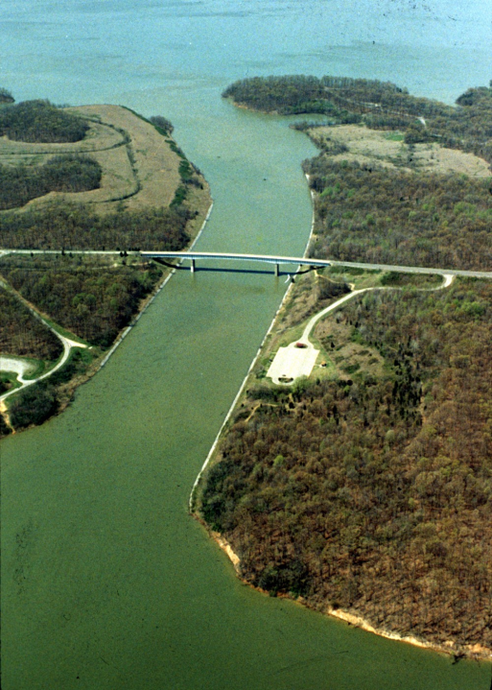
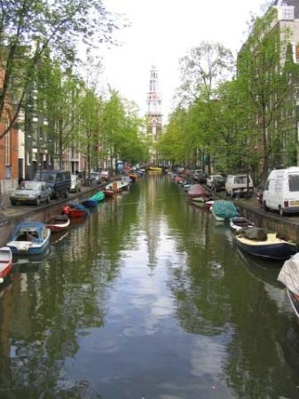
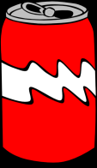
CANALS
Canals are human made waterways.
The Mesopotamians used canals to irrigate their land.
They dug canals and ditches that brought water to
their fields.
Imagine a CAN floating
down a CANal

Slide 11
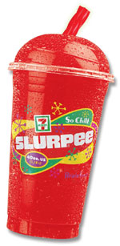
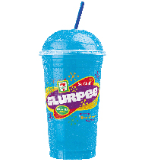
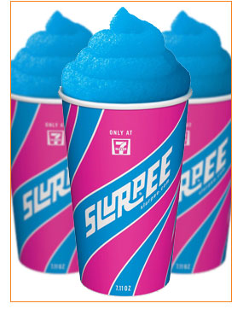
SURPLUS
Surplus is more of something than what is needed.
After the farmers used irrigation systems they were able to make a
surplus of food. They had more food than they needed.
“SIR! We have a SURPLUS of SLURPEES!”

Slide 12
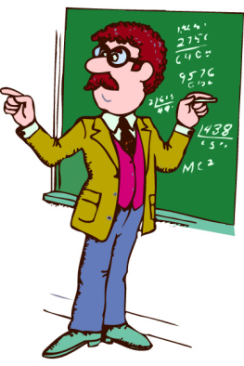
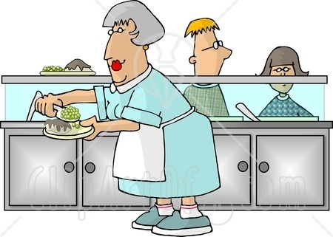
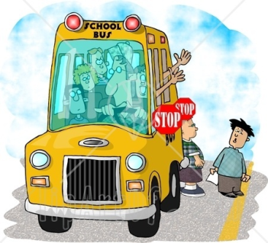
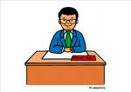
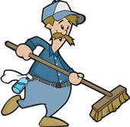
DIVISION OF LABOR
The type of arrangement in which each worker
specializes in a particular task or job.
In Mesopotamia, once irrigation systems were formed people could be divided up into different
jobs such as crafters, religious leaders, and government workers.
How is the labor divided in our school?

Slide 13
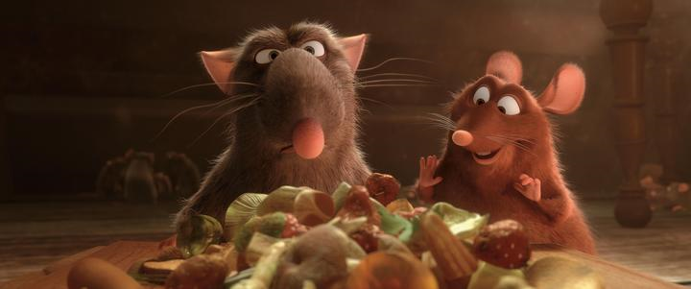
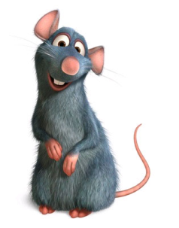
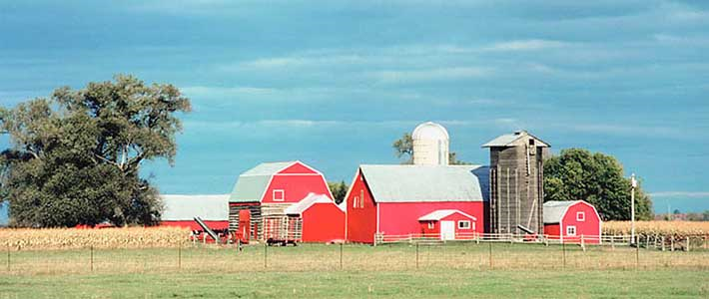
RURAL
A countryside area.
In Ratatouille, Remy the rat lived on a rural farm with his rat family.

Slide 14
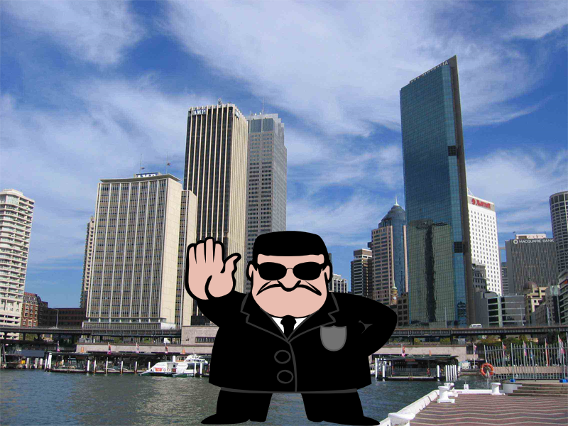
URBAN
A city area.
“ Stop right there! You’re banned from this city!”

Slide 15
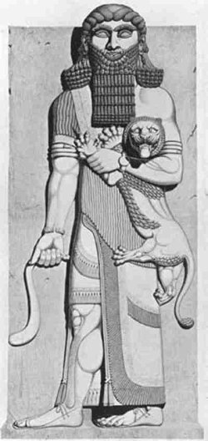
Gilgamesh
Gilgamesh was King of Uruk, a city-state in Sumer.
Gilgamesh was a strong, beautiful,
and brave leader.
“Don’t mesh with Gilgamesh!”

Slide 16
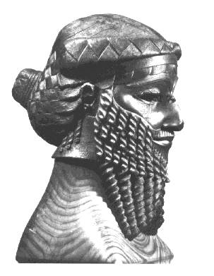
SARGON
Sargon was the Akkadian creator and emperor. He ruled from 2334-2279 BC.
Sargon created the Akkadian society along the Tigris and Euphrates. It was just north of Sumer, but the Akkadians were not Sumerians. The Akkadians even spoke a different language than the Sumerians. For a long time the Sumerians and Akkadians lived in peace, until Sargon broke the peace.
Sargon broke the peace when he decided he wanted to extend the Akkadian territory. He wanted it to be bigger and stronger. Sargon got many soldiers together to fight the city-states of Sumer. Sargon was the first ruler to have a permanent army. Sargon also established the world’s first empire.

Slide 17
EMPIRE
An empire is a land with different territories
and people under a single rule.
What was the world’s
first empire?
The Akkadian Empire
Who was the emperor of the
Akkadian Empire?
“I am your single ruler!”
Sargon
EMP RE

Slide 18
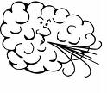
Polytheism
The worship of MANY gods.
The Sumerians practiced polytheism. A long time ago the Sumerians didn’t know how to explain things scientifically. They did not know why it rained or snowed. They did not know why lightening struck, or how the plants grew. They explained things by saying the gods had enormous powers. They believed the gods could bring good health and wealth.
*The Sumerians believed that success in areas of life depended on pleasing the gods, so they were VERY religious!
Some Sumerian gods included:
Enlil: Lord of the air
Enki: God of wisdom
Inanna: Goddess of love and war

Slide 19
SOCIAL HIERARCHY
The division of society by rank or class.
Hint:
How was Sumer divided?
Social HIGHERarchy-
Some people are higher
than others are.
KINGS
The kings of Sumer claimed that the
gods chose them to rule.
PRIESTS
Because of how important religion was
in Sumer, Priests were very high up.
MERCHANGS/TRADERS
Below priests were skilled craftspeople, merchants
and traders. Trade was VERY IMPORTANT!
WORKING CLASS
Farmers and laborers made up the
working class.
SLAVES
Slaves were at the bottom of
social order.

Slide 20
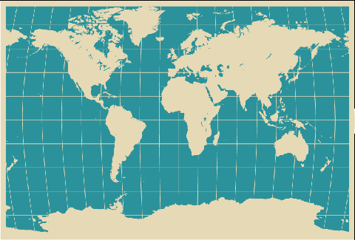
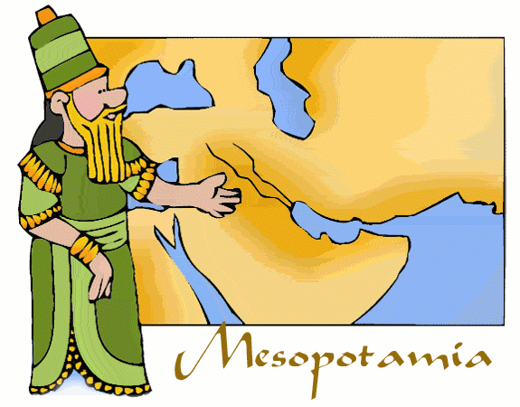
Mesopotamia
Where is Mesopotamia?
Mesopotamia lies within the Fertile Crescent.
Mesopotamia is between Asia Minor and the
Persian Gulf.
Mesopotamia is modern day ____________.
Mesopotamia
is here
We live here
Iraq
Where did the name Mesopotamia come from?
Mesopotamia actually means “between the rivers” in Greek.
What two rivers is Mesopotamia located in between?
The Tigris and
Euphrates!

Slide 21
Ancient Sumer
An Advanced Society
In Southern Mesopotamia, the Sumerians developed the world’s first civilization.
By 3000 BC, several hundred thousand Sumerians settled in Mesopotamia, in the land
they called Sumer. They created an advanced society.
The City-States of Sumer
Sumerian Achievements
Sumerian Social Order
Sumerian Religion
Men and Women in Sumer

Slide 22
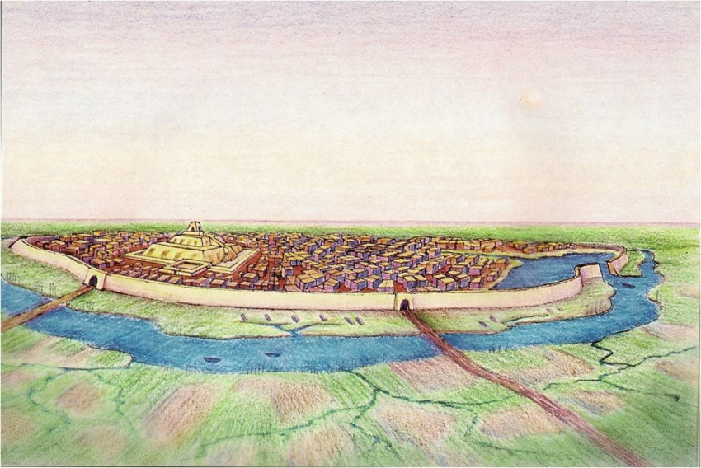
The City-States of Sumer
Most people who lived in Sumer were farmers. Most people lived in rural areas.
The centers of Sumerian society, however were in the urban areas. The first cities had about 10,000 people.
Historians think that by about
2000 BC, some of Sumer’s cities had
more than 100,000 residents.
Did you know that about
8,000 people live in the
Town of Livonia?
Sumer was divided into different city-states. City-states included a city and all of the rural
land around it. Some city-states were larger and stronger than others. The city-states in
Sumer fought each other for farmland. Since there was fighting going on each city-state built
up an army. The Sumerians also built strong walls around cities for protection. (like the one in
the picture above)

Slide 23
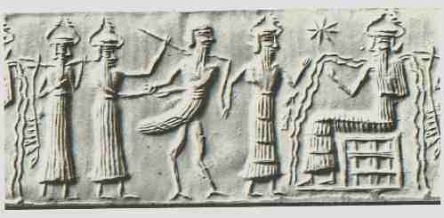
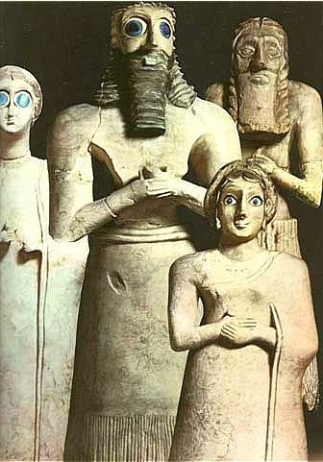
Men and Women in Sumer
Men and women in Sumer had different roles. Men mostly held political power. They made all of the laws. Women took care of the home and the children.
Usually, men were the ones who were educated. Some upper-class women received education as well.
The women who were educated could become priestesses in Sumer’s temples. Some priestesses helped shape Sumerian culture.

Slide 24
Sumerian Achievements
Sumerian society was advanced in terms of religion and government organization. The Sumerians were responsible for many other achievements which were passed down to later civilizations.
The Sumerians had a very advanced…
Writing System (Known as cuneiform)
Technical Advances (Most importantly the wheel and plow)
Math and Sciences (Including a number system and medicine)
Arts and Architecture (Buildings, jewelry, and pottery)

